Slide 1
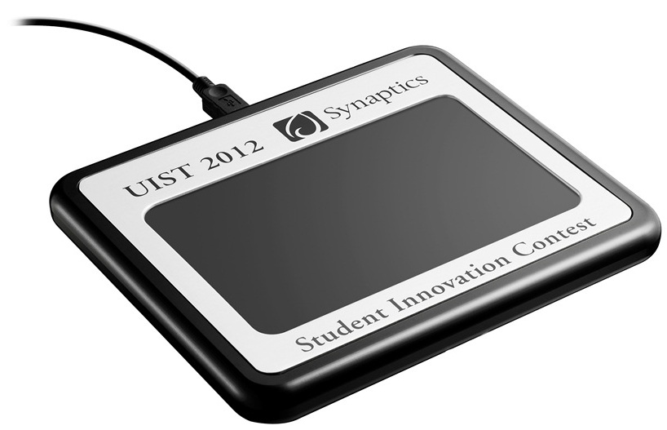
UIST Student Innovation Contest

Slide 2
The Hardware

Slide 3
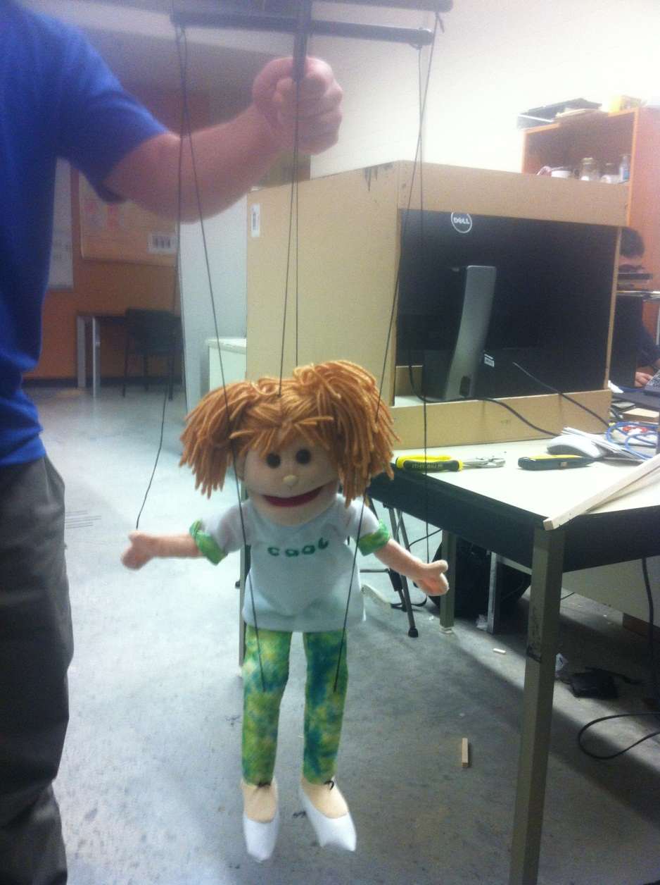
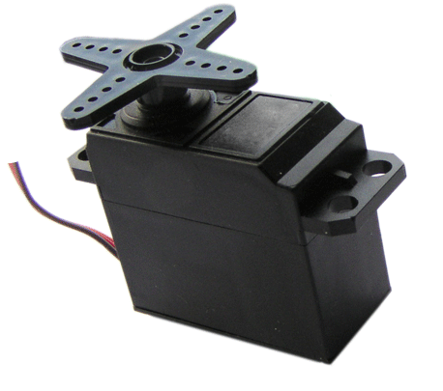
The Idea

Slide 4
The Software
The application will map finger information from the ForcePad to the relevant Puppet body part
Each finger’s pressure data will control the relative position of the linked body part
The next step will be to identify right and left movements of the hand and move the puppet in those directions
Next we will record complete movement segments and automatically play when needed

Slide 5
Short Demo

